Slide 1
LSST Jupyterhub
Gareth Francis
g.francis@epcc.ed.ac.uk

Slide 2
Overview
Jupyter notebooks are becoming popular amongst astronomers as a convenient way to explore and analyse data
The Jupyter notebook is part of the LSST Science Platform Design
Objective of this project is to prototype a JupyterHub environment that will ultimately be deployed as part of the LSST UK Data Access Centre

Slide 3
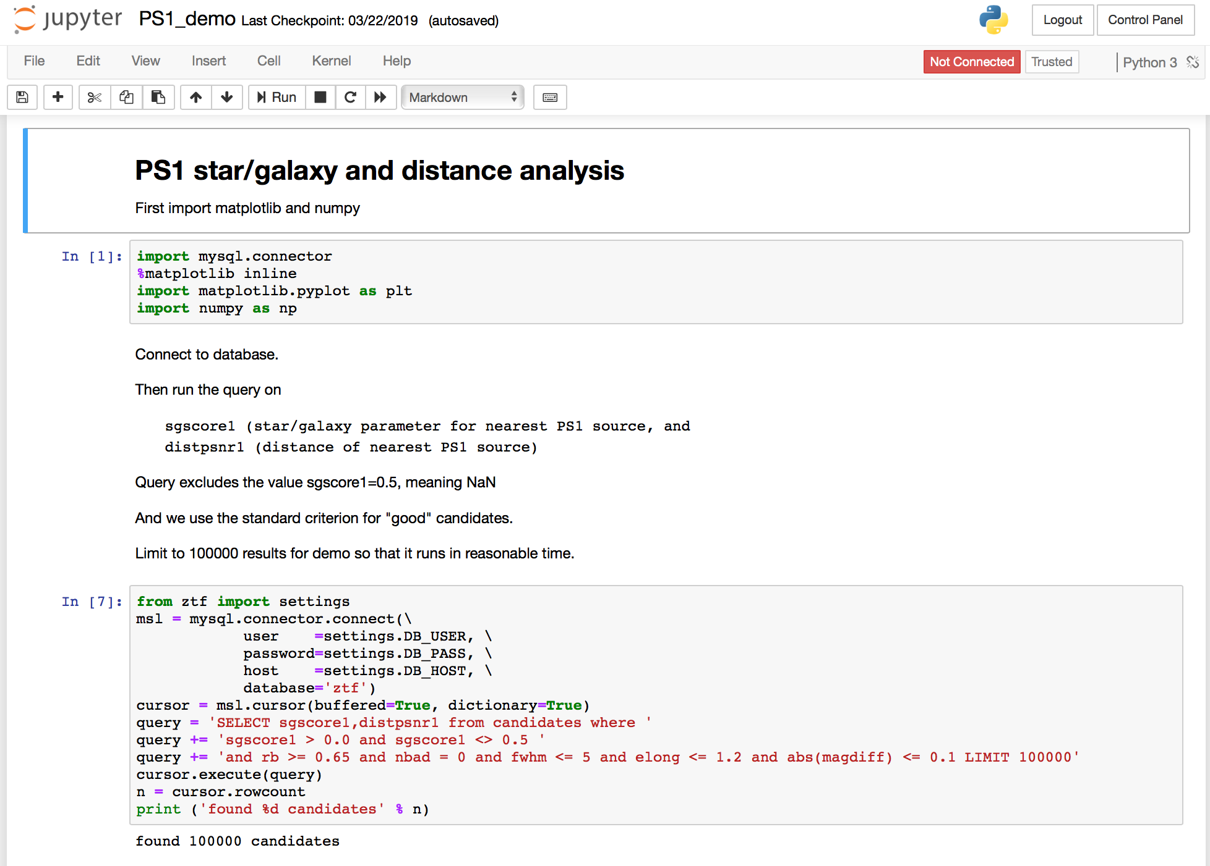

Slide 4
Deployment - Kubernetes
Targets an OpenStack cloud – currently STFC OpenStack
Use Rancher to deploy a K8s cluster
Have also tested Magnum (on AlaSKA)
Rancher
Kubernetes
OpenStack

Slide 5
Deployment – Additional services
Reverse proxy
Local Docker repository
ELK for logging
Rancher
Kubernetes
Proxy
ELK
Docker repo
OpenStack

Slide 6
Deployment – JupyterHub
Use Helm to deploy JupyterHub
JHub
Rancher
Kubernetes
Proxy
ELK
Docker repo
OpenStack

Slide 7
Usage
Users connect to JupyterHub
Hub spawns Jupyter servers on demand
Jupyter
JHub
Jupyter
Jupyter
Rancher
Kubernetes
Proxy
ELK
Docker repo
OpenStack

Slide 8
External services
EGI Check-in for AAI
GitHub for example notebooks etc.
GitHub
Check-in
Jupyter
JHub
Jupyter
Jupyter
Rancher
Kubernetes
Proxy
ELK
Docker repo
OpenStack

Slide 9
Next phase
Get some users!
Usage accounting
Database integration
Data sharing
Integration with Spark/external job systems
Service robustness
Security and user/group isolation

Slide 10
Issues for IRIS
Can we get Magnum as standard?
How can we scale up/down to cope with demand peaks?
How do we handle running on multiple sites?

Slide 11
Questions?
GitHub: https://github.com/lsst-uk/jhub-test

