Slide 1

FY18 Status and FY19 Plans
Gordon Brown
IRIS Face to Face
3rd April 2019

Slide 2
Outline
Overview of FY18 work
Plans for FY19
Current status

Slide 3
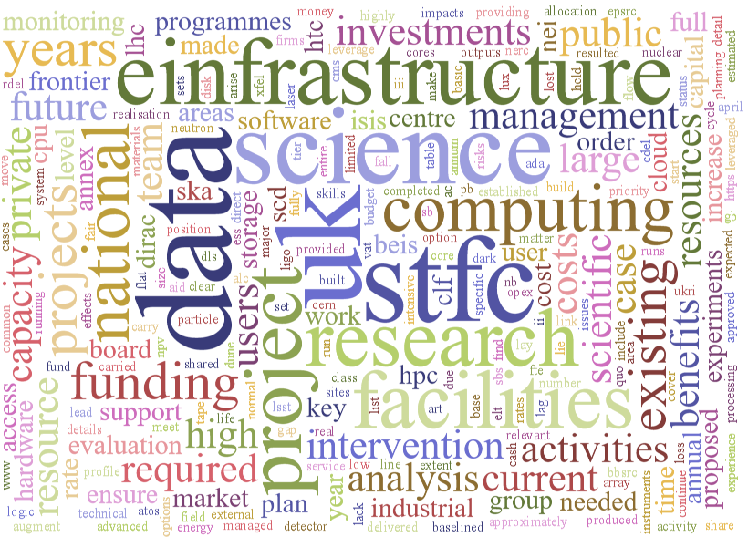

Slide 4
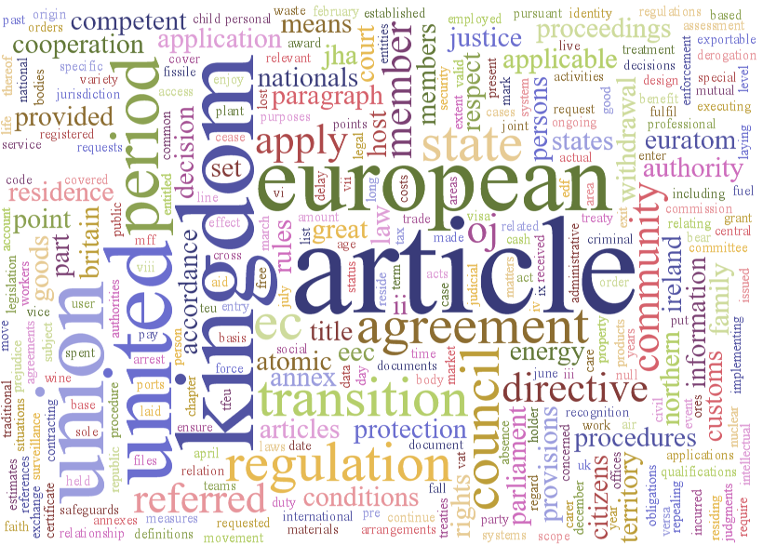

Slide 5
FY18

Slide 6
FY18 – Status
Spend came in on target
  £1.2M
    £900K digital assets
    £300K hardware
Recruitment has been challenging
Hardware purchases complete (just!)
  “Fast” filesystem for SCARF cluster
    Helpful for Diamond and ISIS to move data round
  GPUs for cloud
    For cross-facility data analysis
Collaboration agreement in place
  Took many iterations
  Helpful for future

Slide 7
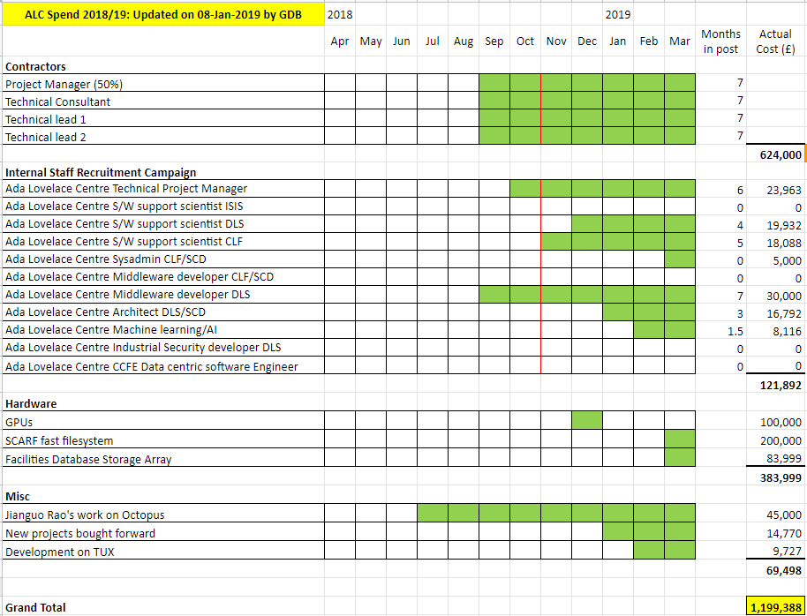

Slide 8
Digital Assets for FY18
Diamond Datastore
OCTOPUS
Data Analysis as a Service
TUX
PILOT: Industrial Security
PILOT: Machine Learning

Slide 9
FY18 Projects
DIAMOND DATASTORE
A major initiative to provide a scalable data store for Diamond Light Source
  To replace current archive (12 years old, 13PB and “creaking”)
ALC Funding: Architects
Current activities
  Engaging with major stakeholders
  Key data management problem areas identified
  Integration with existing systems and user requirements
Discussions on similar use cases and technology with other IRIS partners, key collaborators in UK and abroad, and Industry
Face-to-face planning meeting was in February
Emphasis is to keep trying things rather than a long, drawn out plan

Slide 10
FY18 Projects
Data Analysis as a Service
Bringing data, software and processing together
ALC Funding: Developer, Services Manager & Technical Project Manager
Completed work
  Data Movement Service Project to move data and the associated permissions nearer to the VM
  New environments for ISIS
Upcoming
  Exploring using external clouds
  Extending the range and type of experimental techniques environments available
  Service and production readiness continues

Slide 11
FY18 Projects
Data Analysis as a Service
Moving DAaaS to production for ISIS (IDAaaS)
Status
  Two environment completed (Excitations and WISH), more to follow
  Focus on production readiness and service management
  Used the February beam time for assessing service readiness with on-call to follow
Staff
  New ALC Technical Project Manager (Lesley Mansfield)
  New ALC Services Manager (Julimar Romero)
  New technical staff in place (Jeremy Spencer)

Slide 12
FY18 Projects
OCTOPUS
Based in Central Laser Facility, Octopus is an imaging cluster offering a range of imaging techniques including multidimensional single molecule microscopy, confocal microscopy and optical profilometry
ALC Funding: Developers & SysAdmins for data workflow
Completed work
  Unify authentication
  Build a system where OCTOPUS users can use the SCARF CPUs and GPUs to get on-the-fly analysis
Integrate with Data Analysis as a Service
Continue data modelling

Slide 13
FY18 Projects
TUX
Providing a streamlined tomography processing solution to the UK facilities, as well as the wider Imaging community
ALC Funding: Developer
Current status
  Two project meetings have been conducted, the kick off and first project meeting, these have been well received and a clear plan proposed
  Work started on the web-based User Interface for Savu
  Work on better integration of CCPi tools with Savu, specifically the regularisation toolbox which works well with Neutron Data

Slide 14
FY18 Projects
PILOT: MACHINE LEARNING
ALC Funding: Developer
Job Specification
  Data scientist to work on projects related to Electron cryo-Microscopy.
  On the Harwell campus, high-end microscopes at eBIC provide a national facility for the community, and are producing up to 10TB of raw data per day.
  To provide analysis tools for the rapid assessment of this data, giving the possibility of real-time feedback to the user on site using AI techniques
  The post is one of several in the SciML Group

Slide 15
FY18 Projects
PILOT: INDUSTRIAL SECURITY
ALC Funding: Developer
Job Specification
  To work with Diamond industrial users, to help them make the most effective use of IRIS/ALC hardware and software
  Interacting with DLS staff scientists and users from the commercial sector to understand their workflows and data security requirements
  Developing and porting code to run effectively on the DAaaS platform, and providing direct support for industry users of the ALC

Slide 16
FY19

Slide 17
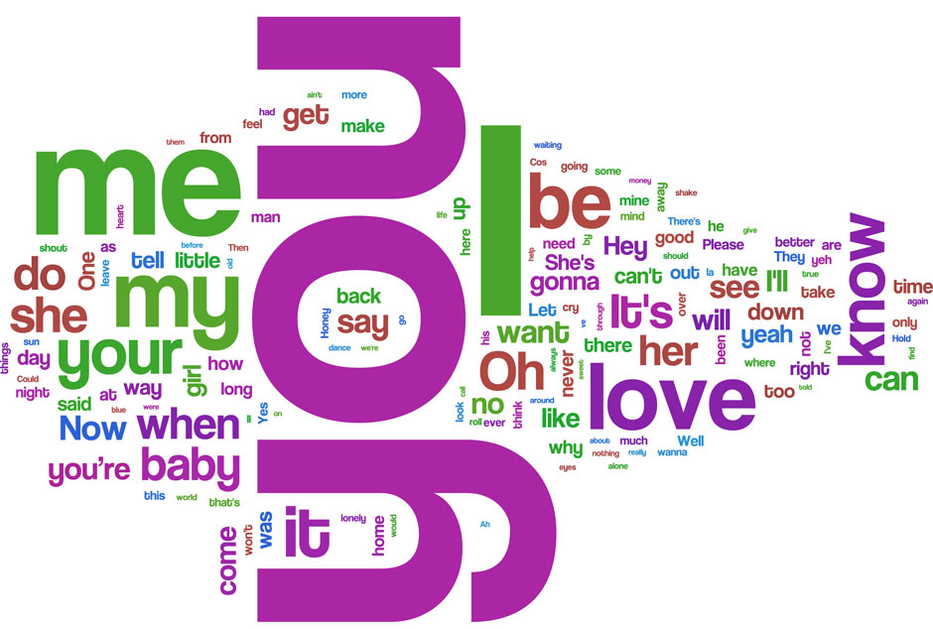

Slide 18
Process for New Projects
The process for selecting the work of the ALC for FY19 was formed by the ALC Steering Group
The proposed work for FY19 is aligned to the core values of the ALC, to develop tools and software to support the work of the Facilities and their users
Complementary to existing funding lines from Scientific Computing Department and the Facilities themselves in developing and fulfilling the goals of the ALC

Slide 19
Overview
Process based on £1.3M spend
  Agreed salary cap and no FEC means 18 posts
Bid process launched (for new and existing projects)
Call was out for three weeks from 25th October
  Should have been earlier and longer
  Form-based responses
  Sent to all ALC relevant contacts
  Maximum of four pages for response

Slide 20
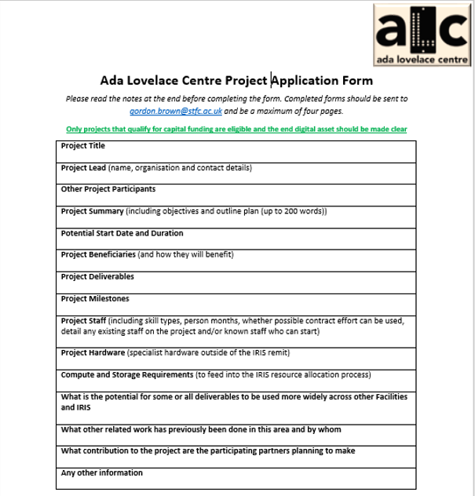

Slide 21
Process for 2019/20 – Project Criteria
SOFTWARE Core values are to develop software tools that reduce the complexity of the computational activities faced by the end user of the National Facilities
COLLABORATION Proposals from more than one organisation and/or proposals that will benefit more than one organization are of preference
DIGITAL ASSETS Digital assets are software packages that are going to be used by the communities and do not include research, prototypes, running services or administration tasks
FIX STUFF NOW Projects should adhere to the underlying principle of the current ALC funding which are to “fix ‘broken stuff’ and enable new opportunities that would be lost if we don’t act now”
IRIS Project should be for the benefit of both ALC and the wider IRIS community i.e. “To share experience and technology as widely as possible, (but only where it makes sense to do so)”

Slide 22
Process for FY19
Steering Group assessed the bids
  Over two meetings
  Breadth of knowledge on Steering Group vital
    Iterated with projects
How useful the projects are to the Facilities and its users?
  Most of the new projects were submitted by instrument scientists, not facility managers
  Instrument scientists (facility staff) are the biggest users of the systems and data and are the right people to provide review of these projects, as they understand the issues facing their users (often better than the users)
  The facility staff need to know their community and collate their requirements.

Slide 23
Process for FY19 - Results
13 bids returned
  ISIS, DLS, CLF, CCFE, SCD all represented
  10 chosen for potential funding
Science Areas
  Neutron total scattering
  Reflectivity
  Muons
  X-rays
  Crystallography
  Chemistry

Slide 24
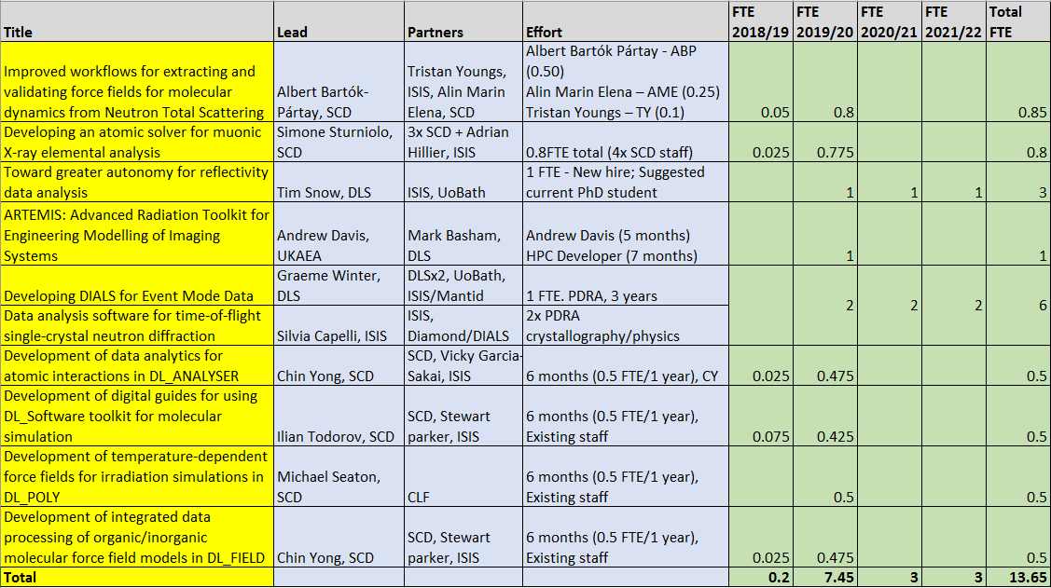
Process for FY19 - Projects

Slide 25
Staff Allocation for FY19

Slide 26
Risk & Mitigation
Risks for the entire IRIS 4x4 project (including the ALC funding) will be detailed in a later document
Biggest risk is recruitment and retention of staff
Mitigation options to the Steering Group include
  Recruiting contractors to perform the duties
  Allocating funds to different projects (within the ALC or wider IRIS community) where staff resource is in place to proceed
  Spend on hardware
  Reallocating spend back to the wider IRIS projects
Regular reporting and governance will be in place through FY19 to keep track of this risk, with updates to the ALC Steering Group and IRIS Delivery Board

Slide 27
Reporting & Governance
For new projects, the Steering Group will ask for
  High-level project plan
  Milestones
  Risks
  Definition of done
This information will complement the details given in the project bid forms
During the course of the projects, quarterly reports will be asked for from all projects that will detail
  Summary
  Costs
  Milestones
  Issues
  Forward plan & resourcing
Necessary recruitment will start on the projects if and when approval is given from the IRIS Delivery Board.

Slide 28
Summary

Slide 29
ALC Status
Projects progressing well despite recruitment challenges
Web presence now critical
ALC Director
  Part-time role to lead science focus
  Oversee strategy and vision
Growing identification
  New starters
  Focus for ALC services
  What do we want to be known for?
Oversight and governance needs work
Face to face meeting later this year

Slide 30
FY19 Project Details

Slide 31
New Projects: Workflow
Project | Improved workflows for extracting and validating force fields for molecular dynamics from Neutron Total Scattering
Science | Neutron Total Scattering
Partners | SCD, ISIS
Resource | 0.85 FTE over 1 year
Summary | Create a workflow for the validation of refined force fields. With already existing experimental data, we will initially focus on simple systems for which FF generation is fully determined, such as liquid argon, water, and benzene, with extension to other systems if time permits. The workflow will target basic properties of potentials such as transferability and reproducibility of dynamics properties. We also intend to explore the possibility of using machine learning techniques to predict properties or changes in structure factor directly from the underlying FF parameters, based on a small number of molecular dynamics runs.
Deliverables | Workflow, integrated in a software package, to validate fitted force fields in two deliverables as follow: 1. Classical simulations workflow for validation of forcefields 2. Machine learning based workflow for validation of forcefields

Slide 32
New Projects: Reflectivity Data Analysys
Project | Toward greater autonomy for reflectivity data analysis
Science | Reflectivity
Partners | DLS, ISIS
Resource | 1 FTE for 3 years
Summary | This project aims to deliver a candidate framework, and complimentary software (the digital asset), for the analysis of reflectivity data obtained from x-ray or neutron sources. Comparable to recent advances for the analysis of small angle scattering data, an adaptable framework of analytical steps for reflectivity data will be devised in collaboration with experts in the field. This will form a traceable analysis procedure that can be configured in advance of measurements, according to sample, allowing automated analysis of data. An input dataset will be designed to be metadata rich, facilitating complimentary, or ancillary, data mining or Machine Learning projects for reflectivity datasets to complement ongoing effort within SCD, led by Rebecca Mackenzie.
Deliverables | - Primarily the digital asset, namely, an analytical software package capable of interpreting the project defined input format and providing a stepwise implementation of the analytical framework (cf. DAWN’s processing perspective https://confluence.diamond.ac.uk/display/SCATTERWEB/Reducing+data+from+I22+using+DAWN) - A working, automated, implementation of the digital asset at I07 at Diamond Light Source - A working, automated, implementation of the digital asset at OFFSPEC at ISIS - Training for the user community in the shape of formal courses held at RAL, outreach to visiting user groups, visits to Universities and an e-learning module. - An open access journal article outlining the analytical framework - A series of workshops to engage the user community with the project - A specification for a metadata rich, NeXus/HDF based, input format published on www.nexusformat.org

Slide 33
New Projects: Muonic X-ray Elemental Analysis
Project | Developing an atomic solver for muonic X-ray elemental analysis
Science | Muons
Partners | SCD, ISIS
Resource | 0.85 FTE over 1 year
Summary | We plan to produce a tool able to predict muonic X-ray energies and intensities for most elements of the periodic table in any oxidation state with reasonable accuracy, making use of existing know how and code from electronic density functional theory solvers as a starting point. This could eventually become a valuable part of a proper analysis and fitting tool for this technique (to be incorporated for example in Mantid).
Deliverables | A software tool able to produce predicted muonic X-ray lines for any element and oxidation state. Space should be left open for the introduction of additional functionality, such as accounting for the chemical environment or nuclear finite size effects in more detail.

Slide 34
New Projects: ARTEMIS
Project | ARTEMIS: Advanced Radiation Toolkit for Engineering Modelling of Imaging Systems
Science | X-rays
Partners | CCFE, DLS
Resource | 1 FTE for 3 years
Deliverables | The ARTEMIS toolkit will deliver: 1. Code to generate DAGMC enabled executable based upon an appropriate solver (e.g. meeting the requirements of performance, open source technology etc.) - DAG-EGSNRC, DAG-Penelope, or some other existing code for CT radiographs. 2. Tool to generate DAGMC geometry from input CAD. 3. Tool to generate density enhanced geometry from FE simulation. 4. Job scripts to generate and post process inputs to generate CT images.

Slide 35
New Projects: DIALS
Project | Developing DIALS (Diffraction Integration for Advanced Light Sources) for Event Mode Data
Science | Crystallography
Partners | DLS, ISIS
Resource | 1 FTE for 3 years
Summary | Within DIALS we have developed a user-friendly pipeline, from diffraction images through to scaled intensities. The purpose of this project is to extend this to event mode data, allowing direct analysis of the raw data stream and improved modelling of the time evolution of the crystal structure. It will also help to bridge the gap in data treatment between X-ray and pulsed neutron facilities.
Deliverables | 1. Tool to generate pseudo-event-mode data from photon counting detector data sets for testing and evaluation 2. Tool to reconstruct images from LATRD event data (including filtering) for initial stages of processing, and DIALS pipeline support for resulting images 3. Mechanism to record the full modelling path from the binned data through to the final intensity data i.e. relationship between pixel values from images to final intensity measurement 4. Tools to apply these models to filtered subsets of events to allow finely grained time-resolved intensity measurements to be constructed 5. Tools and methods to interpret event stream based on a current atomic structure via inversion of the data processing models

Slide 36
New Projects: DIALS
Project | Data analysis software for time-of-flight single-crystal neutron diffraction
Science | Crystallography
Partners | ISIS, DLS
Resource | 1 FTE for 3 years
Summary | This project aims to expand DIALS in order to treat single-crystal neutron diffraction data and integrate the required routines into the general layout of MANTID. This will result in powerful tools for structural studies across a broad range of disciplines ranging from biology to materials science, both with neutron and X-rays, at a number of large scale facilities.
Deliverables | 1. Treatment of neutron diffraction data in DIALS. Whilst some of the current routines in DIALS can be easily adapted to treat neutron diffraction data, additional functionality will need to be developed (see below). 2. Automatic procedures for routine data processing of single crystal neutron diffraction measurements performed on the SXD and WISH diffractometers at ISIS within Mantid. Due to the strong asymmetry of the peak shape from a time-of-flight source, 3D peak fitting is essential to extract more reliable intensities than is currently done with a simple shoebox integration approach. 3. The provision of new capabilities within MANTID and DIALS to extract peak intensities in more difficult cases. These will include: i) the treatment of overlapping peaks arising from multiple or twinned crystals and the ability to distinguish between the two cases, and ii) the indexing and integration of incommensurately modulated structures. 4. The development of new routines to be used within both DIALS and Mantid for the data corrections required at a pulsed neutron source such as ISIS. These will take into account the (wavelength dependent) absorption and extinction effects and be applicable to irregular shaped crystals.

Slide 37
New Projects: Chemistry
Project | Development of data analytics for atomic interactions in DL_ANALYSER
Science | Chemistry
Partners | SCD, ISIS
Resource | 6 months
Summary | Workflow enablement of DL_ANALYSER to detect, annotate and quantify various modes and types of atomic interactions in general molecular systems to the benefit of current ISIS studies. Enable the analysis of complex hydrogen bond (HB) network interactions at the aqueous biomaterial interfaces.
Deliverables | 1. Development of new features in DL_ANALYSER to detect and annotate interactions among water molecules and biomaterials. (4 months) 2. OpenMP implementation to enable concurrent analysis capability, especially atomic interaction analysis on large simulation models. (1 month) 3. Software testing for robustness, reliability and performances. (1 month)

Slide 38
New Projects: Chemistry
Project | Development of temperature-dependent force fields for irradiation simulations in DL_POLY
Science | Chemistry
Partners | SCD
Resource | 6 months
Summary | Develop methods to incorporate temperature-dependent force fields (FFs) in DL_POLY for more accurate simulations of laser and swift heavy ion irradiation processes
Deliverables | 1. Addition of temperature-dependent potentials in DL_POLY (including determination of input file formats): both temperature-dependent potential parameters and multiple tabulated potentials. (5 months) 2. Software testing for robustness, reliability and performance. (1 month)

Slide 39
New Projects: Chemistry
Project | Development of integrated data processing of organic/inorganic molecular force field models in DL_FIELD
Science | Chemistry
Partners | SCD, ISIS
Resource | 6 months
Summary | Facilitate a workflow for model preparation and force field (FF) conversion of zeolite-based inorganic-organic systems via DL_FIELD for use in MD simulations via DL_POLY.
Deliverables | 1. Testing of multiple-potential capabilities of DL_FIELD to improve model conversion work flows (1 month) 2. Inclusion of force field features to map zeolites (1 month) 3. Inclusion of auto-mixing of short range non-bonded interactions between organic and inorganic systems (4 months)

Slide 40
New Projects: Training Materials
Project | Development of digital guides for using DL_Software toolkit for molecular simulation
Science | Chemistry
Partners | SCD, ISIS
Resource | 6 months
Summary | Facilitate training and knowledge transfer for classical models preparation (model setup), equilibration and specific simulation options and techniques to calculate materials properties, as well as collect and visualise trajectories involving the DL_Software suite of programs. To minimise pitfalls committed by novice and new users in molecular simulations and ensure correct simulation protocols are followed.
Deliverables | 1. DL_POLY Digital Guides (for molecular simulations) 2. DL_FIELD Digital Guides (for force field application and model setup) 3. DL_MESO Digital Guides (for mesoscopic simulations) 4. DL_ANALYSER Digital Guides (for results analysis) 5. DL_MONTE Digital Guides (for Monte-Carlo simulations)

