Slide 1
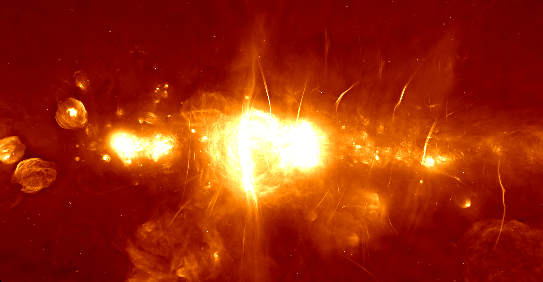


Recent SKA activities
AENEAS : An SKA Regional Centre for Europe
Develop a concept and design for a distributed, federated European Science Data Centre (ESDC) to support the astronomical community in achieving the scientific goals of the Square Kilometre Array
Rohini Joshi
University of Manchester
Credit: SARAO
IRIS F2F MEETING CAMBRIDGE APR 2019
Advanced European Network of E-infrastructures for Astronomy with the SKA AENEAS - 731016
Notes:
aeneas is a H2020 European ska regional centre design project and is an ska affiliated activity while strictly not ska

Slide 2
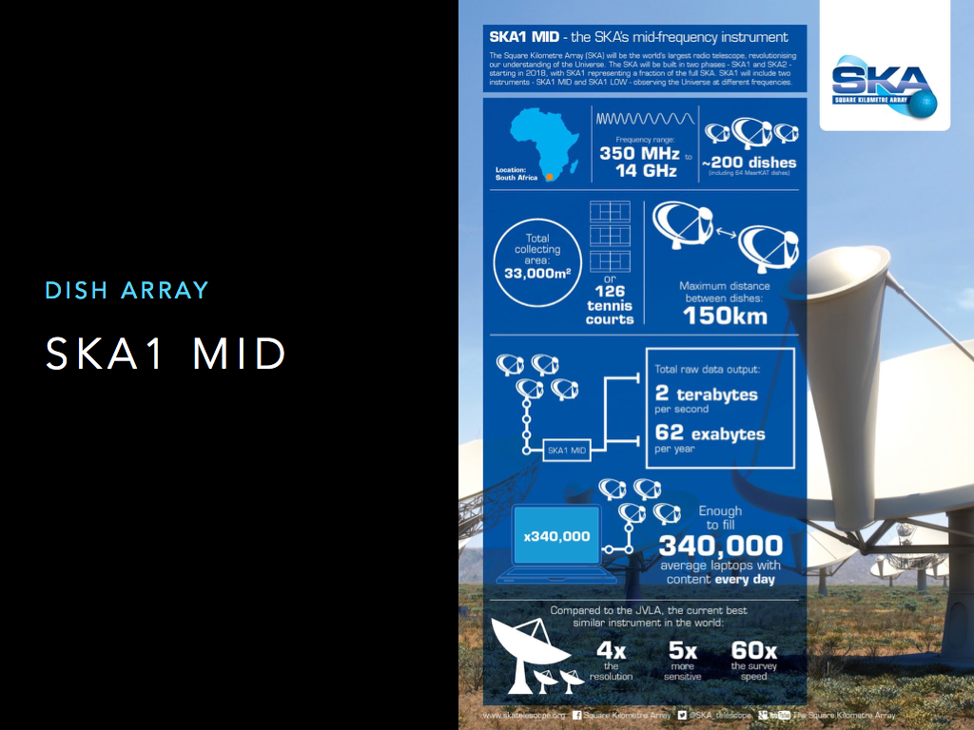
Notes:
boilerplate info slides in case someone is interested. lots of data

Slide 3
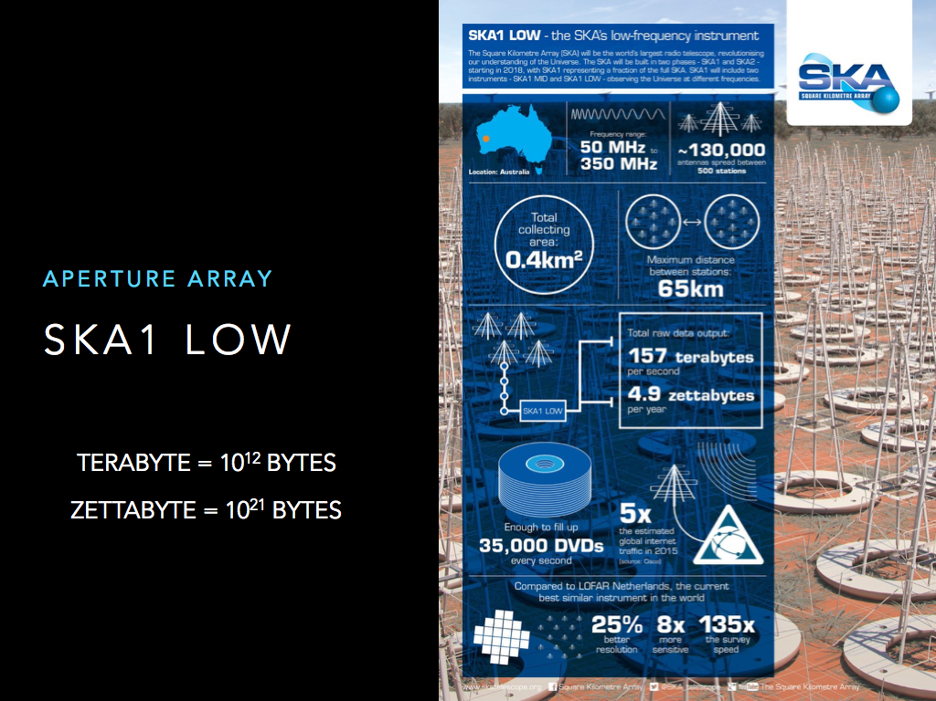
Notes:
and then some more data

Slide 4
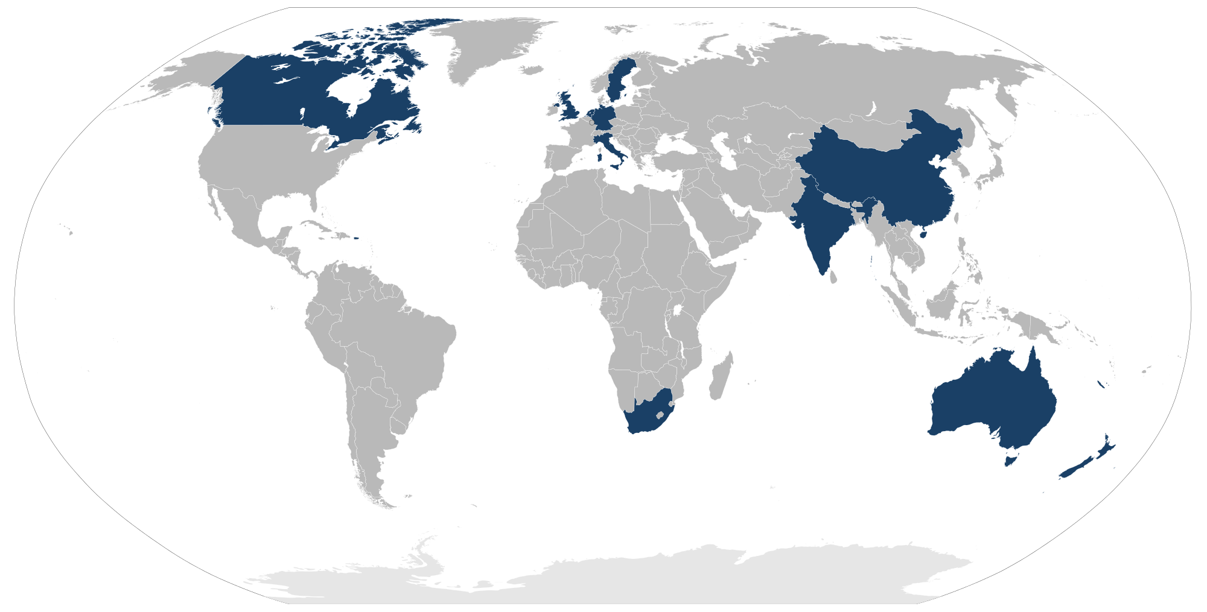
THE SQUARE KILOMETRE ARRAY
Science Data Processors at both the SKA sites will collect, process and churn out science data products that will be pushed out to one or more regional centres around the world
MEMBER COUNTRIES
Australia
Canada
China
India
Italy
Netherlands
New Zealand
South Africa
Sweden
UK
Potential new members: Spain, Portugal, Germany, France, others
SKA Headquarters, Jodrell Bank, UK
Host country for SKA-MID
Host country for SKA-LOW
IRIS F2F MEETING CAMBRIDGE APR 2019
Advanced European Network of E-infrastructures for Astronomy with the SKA AENEAS - 731016
Notes:
of key importance to the regional centres will the data links from sdp to src. data is being pushed out of sdp to src, unidirectional and across very high speed

Slide 5





SKA REGIONAL CENTRES
SKA Regional centres will provide a platform for data access, data distribution, post-processing, archival storage, and software development.
ARCHIVE
DATA DISCOVERY
DISTRIBUTED
DATA PROCESSING
USER SUPPORT
INTEROPERIBILITY
Archival of the raw data but also once scientific results are published, but outputs of analysis are made available.
SDP has pushed the data to the regional centres, now what? How will users find/peruse their data. How will published results be easily found?
Use cases are made to be reproducible. Compute comes to the data (high data volume).
SRCs must support the key science project teams as well as general users. This will mean user ability with be varied.
Multiple regional SRCs, locally resourced but interoperable. SRCs may be heterogeneous in nature but with common core functionality
IRIS F2F MEETING CAMBRIDGE APR 2019
Advanced European Network of E-infrastructures for Astronomy with the SKA AENEAS - 731016

Slide 6
CHALLENGES
(known)
DEVELOPING TRUST IN THE USER COMMUNITY TOWARDS THE SYSTEM
DIVERSE DATA/NON-HOMOGENEITY OF DATA
Diversity in data volumes, data formats, number of files, necessary structuring of data, access, what sort of secondary data products are generated. Regional centers must adhere to the data policies as defined by the SKA.
DISTRIBUTED RESOURCES, DISTRIBUTED USERS
Data and compute resources will be distributed, with a software stack such that a unified portal is shown to the user. Users will likely by few thousand.
DATA VOLUME
SKA Phase 1 Science archive is likely to be 300 PB per year. The regional centers would need to host advanced data products in addition to this.
IRIS F2F MEETING CAMBRIDGE APR 2019
Advanced European Network of E-infrastructures for Astronomy with the SKA AENEAS - 731016
Notes:
to that end we are hosting some workshops and rachael has created some starter git repos to help onboard users

Slide 7
TYPICAL USE CASES
CALIBRATION OF UV DATA
Direction independent calibration is a multi stage process with alternate parallel and aggregation steps. Input data ~ 3-4 TB reduced to 500 – 700 GB. Direction dependent calibration is a lot more computationally/memory intense , ~256 GB RAM
PULSAR RE-FOLDING (GENERATING TEST VECTORS)
Single core, Low memory jobs that produce outputs of the order few 10s of GB. Simulating test vectors single core, 30-40 GB RAM, produces outputs with similar size
IMAGING OF CALIBRATED DATA
Highly computationally intensive, memory intensive due to nature of algorithm
MACHINE LEARNING
Convolutional Neural Network to detect and classify large number of galaxies found in an image (GPU required for training)
Random Forest classification for multi-wavelength photometry and finding new sources
DATA PRODUCTS
These will vary from few GB per observation to several hundred. And data archives over time vary from few hundred GB to few hundred PB (from experiment to experiment). Users consuming data will also be generating secondary data which may not be smaller than raw data
IRIS F2F MEETING CAMBRIDGE APR 2019
Advanced European Network of E-infrastructures for Astronomy with the SKA AENEAS - 731016

Slide 8
WHAT WE HAVE TESTED SO FAR
Data being used is astronomy data from pathfinder instruments although the volumes are not analogous to SKA data volumes
WORKFLOWS ON THE GRID
Most workflows are set up to run on the grid, we are acquiring more input data to run the same at scale
RUCIO TESTING
Distributed data management crucial aspect of a regional centre. Data moved from SA to UK, ElasticSearch integration ongoing.
DiRAC TESTING
Preliminary testing of eMERGE use case (representative astronomy imaging use case). Ongoing work for calibration use case
OPENSTACK AT RAL
Instances set up for AENEAS and eMERLIN projects. AENEAS instances set up with required tools for particular use cases.
IRIS F2F MEETING CAMBRIDGE APR 2019
Advanced European Network of E-infrastructures for Astronomy with the SKA AENEAS - 731016

Slide 9
HURDLES
(so far)
X509 CERTIFICATES
Certificates are a deterrent to new users, something to consider when building new interfaces. We are looking into a credential translation solution as an alternative to x509 certificates but it is still cumbersome (in a slightly different way).
INTERACTIVE ACCESS
Large number of use cases have interactive steps interspersed with heavier production-esque ones
ASTRONOMY WORKFLOWS ARE DIFFERENT THAN HEP WORKFLOWS
Data models and compute models are simply not all known at the moment, leaving us to consider for all worst-case scenarios. Large variations in the size of data, number files, metadata, volume of secondary data generated, required proximity of the data.
IRIS F2F MEETING CAMBRIDGE APR 2019
Advanced European Network of E-infrastructures for Astronomy with the SKA AENEAS - 731016
Notes:
we are trying to change the way astronomers work, and when the first step to that is getting an x509 cert, we lose them

Slide 10
LOOKING AHEAD
HIGH MEMORY, “FAT” NODES AT MANCHESTER, MEDIUM AT LANCASTER
Will be available soon. Initially some fine tuning to the use cases will be needed which will be done interactively
RUCIO
ElasticSearch integration, Australian node setup underway, a DIRAC – Rucio collaboration to help replicate a use case end to end
PERMISSIONS
Astronomers like to keep their data protected. Traditionally, once data is available it is accessible only to the authorized people in the project. Once the proprietary period has passed, data is made public. Exploring VO groups to help enable more use cases.
MORE USE CASES, MEERKAT IMAGING, SKA DATA CHALLENGES
One is out now, more will be coming soon.
Thank you!
IRIS F2F MEETING CAMBRIDGE APR 2019
Advanced European Network of E-infrastructures for Astronomy with the SKA AENEAS - 731016

