Slide 1

The IRIS Accounting Portal
Adrian Coveney, Greg Corbett
apel-admins@stfc.ac.uk

Slide 2
Overview
Digital Asset
Data Flow
Portal Demo/Backup Slides
Future Work

Slide 3
Digital Asset

Slide 4
Digital Asset
APEL is providing the resource accounting system for the IRIS project.
This includes a repository to store accounting data and a portal for users to explore the data.

Slide 5
Data Flow

Slide 6
Data Flow
CE
Batch
APEL parser
APEL
APEL
S
S
M
S
S
M
W
E
b
Client
Server
Batch system
ARC / QCG
SSM
ARGO Messaging Service
SSM
cASO / Oneacct
Cloud system
Storage system
Accounting script
SSM

Slide 7
Data Flow - Grid
CE
Batch
APEL parser
APEL
APEL
S
S
M
S
S
M
W
E
b
Client
Server
Batch system
ARC / QCG
SSM
ARGO Messaging Service

Slide 8
Data Flow - Site
APEL Client Supported CEs
  Cream CE
  HTCondor-CE
APEL Client Supported Batch Systems
  LSF
  PBS
  SGE/OGE
  SLURM
  HTCondor

Slide 9
Data Flow - Site
Sites install the APEL software
Client parses the submit host (CE) logs and the worker node logs to create JobRecords
JobRecords stored in client database
Client can then either send individual records or summaries
Site
CE
APEL
APEL parser
S
S
M
Batch
Client

Slide 10
Data Flow - Site
Configuration
  /etc/apel/parser.cfg
  /etc/apel/client.cfg
  /etc/apel/sender.cfg
Logging
  /var/log/apel/parser.log
  /var/log/apel/client.log
  /var/log/apel/ssmsend.log
Site
CE
APEL
APEL parser
S
S
M
Batch
Client

Slide 11
Data Flow - Site
For sites not using the APEL Client it’s a black box as far as the APEL team is concerned
Batch system
ARC / QCG
SSM
  So long as the output is in our record format, we can ingest it regardless of the exact source
  Extract data from your local database and transform it into the APEL Usage Record format
  Sent to us via SSM and the ARGO Messaging Service
  https://wiki.egi.eu/wiki/APEL/MessageFormat

Slide 12
Data Flow - Grid
CE
Batch
APEL parser
APEL
APEL
S
S
M
S
S
M
W
E
b
Client
Server
Batch system
ARC / QCG
SSM
ARGO Messaging Service

Slide 13
Data Flow - SSM
Site
RAL
S
S
M
ARGO Messaging Service
S
S
M
Our messaging software uses the ARGO Messaging Service (AMS) provided by partners in EGI/EOSC-hub
  https://argoeu.github.io/guides/messaging/

Slide 14
Data Flow - Central Server
Rejected Messages
S
S
M
DB
Grafana
Loader
receiver.log
loader.log
summariser.log
Filebeat
Logstash
Elastic Search
Kibana Dashboard

Slide 15
Data Flow - Grid
CE
Batch
APEL parser
APEL
APEL
S
S
M
S
S
M
W
E
b
Client
Server
Batch system
ARC / QCG
SSM
ARGO Messaging Service

Slide 16
Portal Demo/Backup Slides

Slide 17
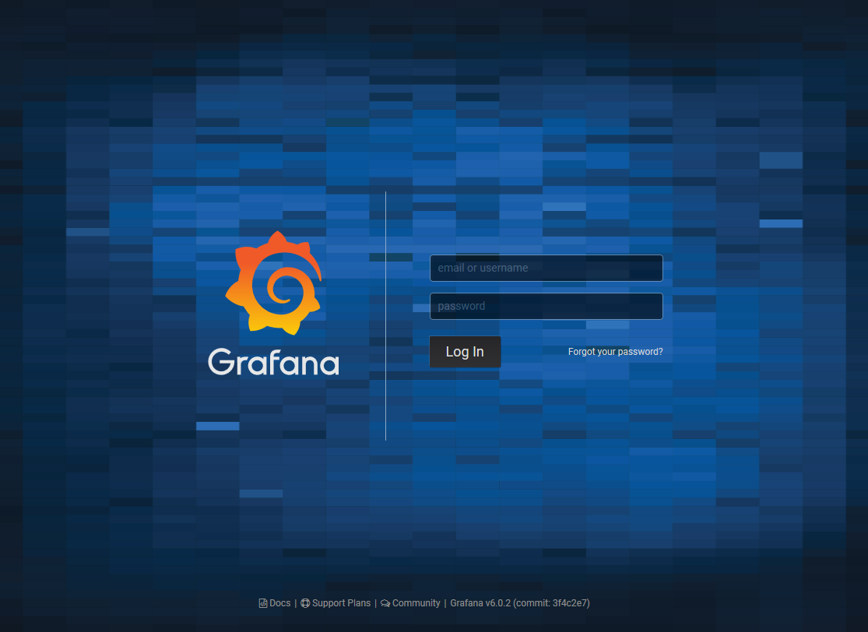

Slide 18
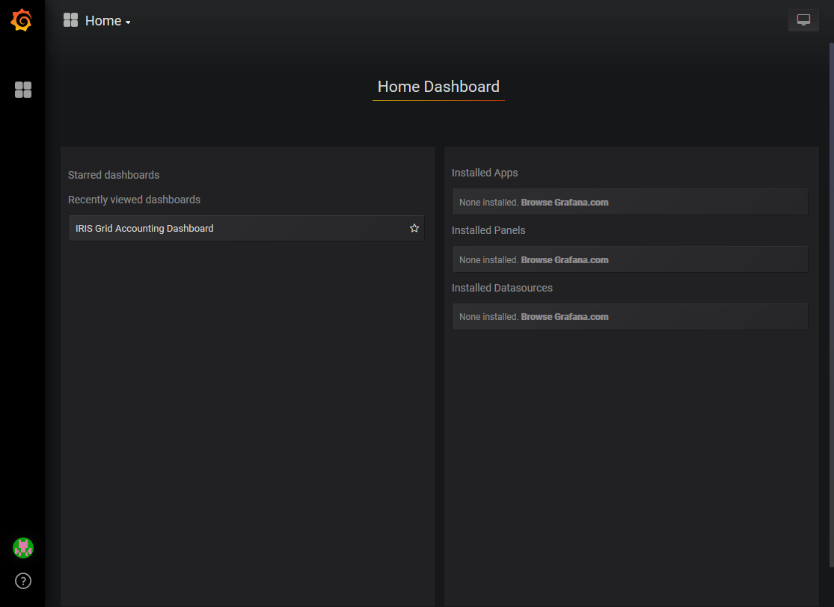

Slide 19
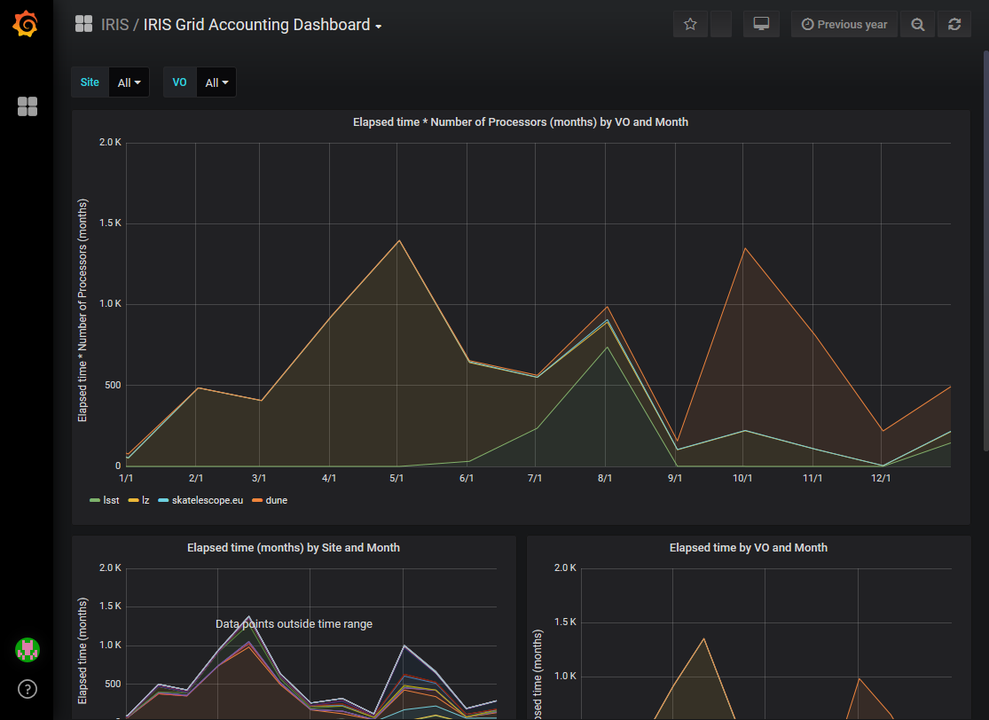

Slide 20
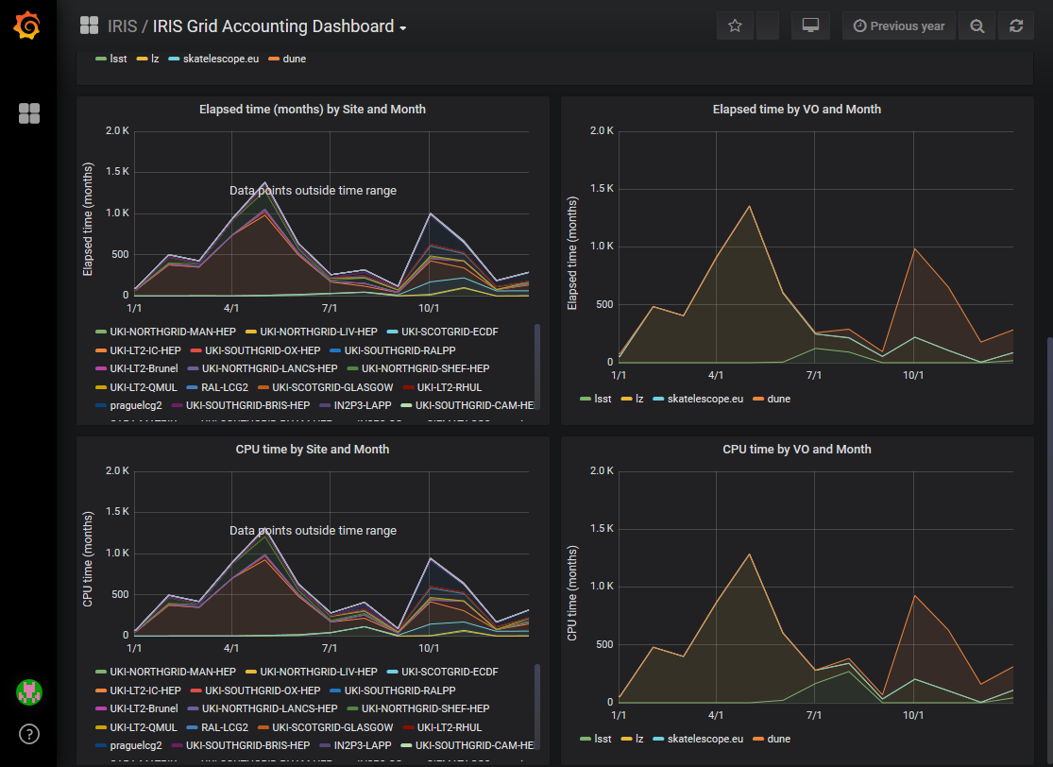

Slide 21
Future Work

Slide 22
Future Work
More data sources to be added (STFC Cloud, DiRAC, etc.)
User made customisable views to be supported.
Second Digital Asset bid submitted:
  Create shared configuration management templates for the service
  New metric, raw unscaled wall clock, to be added to the schema
  Merge schemas used for IRIS and WLCG into shared schema
Aim to develop these features over course of this year

Slide 23
Questions?

